Slide 1
Scalability and Privacy Issues in Social Network
Samir Hasan
COMP 7700: Term Project

Slide 2
Social Network Basics
Caters for three primary needs
Create public/private user profiles
Discover other users with common interests
Browse through friend’s connections
System on the edge
More users → More effective → Higher resource requirements

Slide 3
Essential Quality Attributes: Scalability
Scalability
Accommodate increasing amount of data
Automatically handle increasing load of client requests
Availability
Is the user data readily available?
Very important to ensure good user-experience

Slide 4
Essential Quality Attributes: Scalability
Privacy – the right to be alone
Control who sees what
Is the host system using the private data for purposes undisclosed?
Can the users know what information the system stores for them?
Is he allowed to delete his social activities from the system?

Slide 5
Project Goals
Identify key issues in scalability and privacy in online social networks
System under study
Centralized Systems
Facebook – single organization, client-server architecture
Decentralized P2P Systems
Friendica – decentralized architecture with no central authority
PeerSoN – research prototype built by people from NTU Singapore

Slide 6
Evaluation Criteria: Scalability
Data Store Scalability
Database
Distributed file systems
Synchronization issues
Availability
Application Scalability
Automatic vs Manual scaling of servers
Cost of scaling and maintanence

Slide 7
Evaluation Criteria: Privacy
Privacy from unwanted visitors
Public and private profiles
Control visibility of activities
Prevent unwanted visitors
Privacy from the system
Control system access
Control how much the system tracks
Visibility of tracked data

Slide 8
Overview of Facebook Architecture
Runs on PHP being interpreted as HipHop bytecodes by the HipHop VM
Business logic is exposed as services using Thrift
Persistence – MySQL, Memcached and Hadoop’s Hbase
Offline processing done with Hadoop and Apache Hive
Haystack – ad-hoc storage solution for storing billions of photos
Chat – Epoll server developed in Erlang and accessed using Thrift

Slide 9
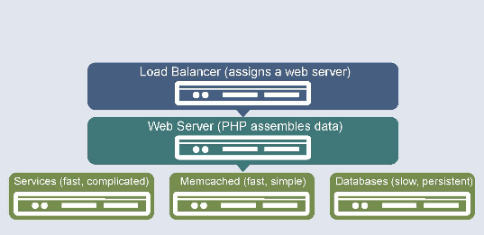
Overview of Facebook Architecture

Slide 10
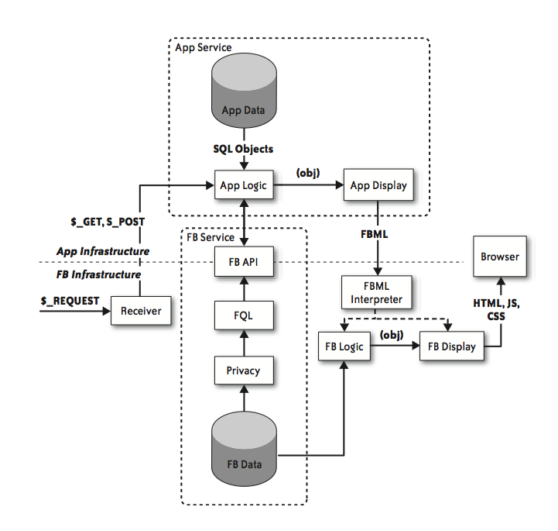
Overview of Facebook Architecture

Slide 11
Next Steps
Comment on the the performance, availability tactics used by Facebook
Identify the scalability, performance and availability tactics for P2P systems
Identify the privacy issues in Facebook and the P2P systems Friendica and PeerSoN
Compare the two systems based on the evaluation criteria

Slide 12
Tentative Schedule
Date | Task
May 9 | Comment on the the performance, availability tactics used by Facebook
May 16 | Identify the scalability, performance and availability tactics for P2P systems
May 23 | Identify the privacy issues in Facebook and the P2P systems Friendica and PeerSoN
May 30 | Compare the two systems based on the evaluation criteria
June 6 | Finish writing the paper

Slide 13
Thank You

